Slide 1
PRIYANK SONI
Master of Technology
INDIAN INSTITUTE OF TECHNOLOGY, DELHI

Slide 2
Agenda
M. Tech Major project
Computer Architecture projects
Operating Systems projects
Data Structure projects
Deep Learning projects
Healthcare Projects

Slide 3

M. Tech Major project
Signature Verification using Deep Convolutional Neural Networks

Slide 4
Introduction:
Aim of the biometric systems is to recognize person based on physiological traits (eg. iris, fingerprint, voice)
Signature verification:
1.Online (dynamic)
2.Offline (static)
Forgeries: Random, Simple, Skilled
Notes:
The handwritten signature is a particularly important type of biometric trait, mostly due to its widespread use to verify a person’s identity in legal, financial and administrative areas. One of the reasons for its extensive use is that the process to collect handwritten signatures is non-invasive, and people are familiar with their use in daily life [2]

Slide 5
Problem statement:
Given a signature image, classify this as a genuine or forgery. (Verification task)
Signature verification system types:
Writer Independent system (WI): Single model is used to classify a signature.
Writer Dependent system (WD): One model is trained for each user.

Slide 6
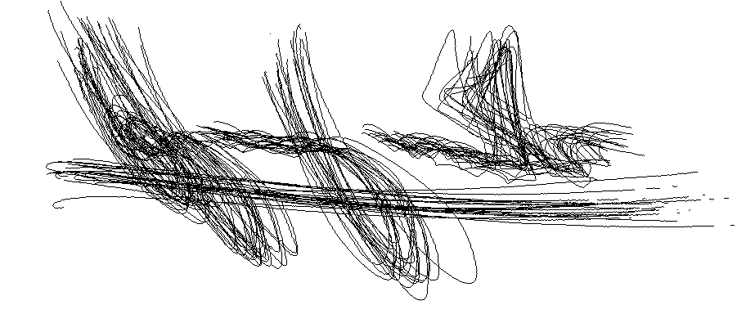
Challenges in signature verification
High intra class variability
Fig: Signatures of same person superimposed (high intra class variability)

Slide 7
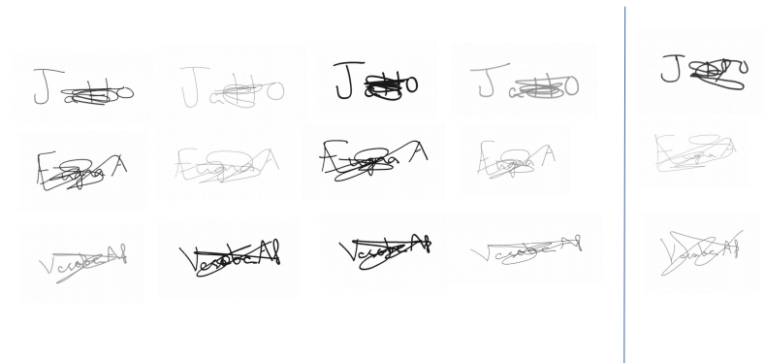
Low inter class variability
Fig: Each row represents 4 genuine signature and 1 skilled forgery (low inter class variability)

Slide 8
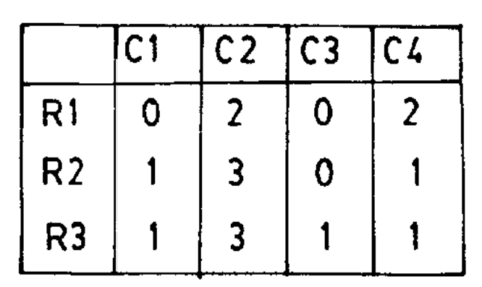
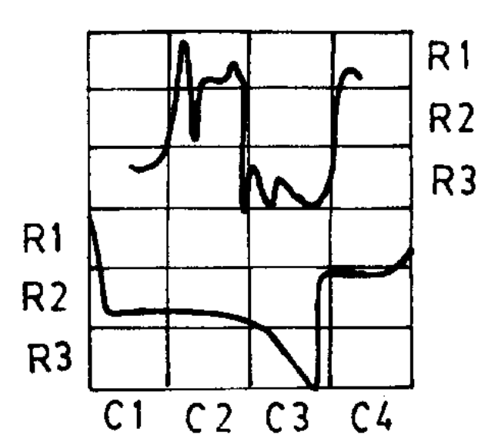
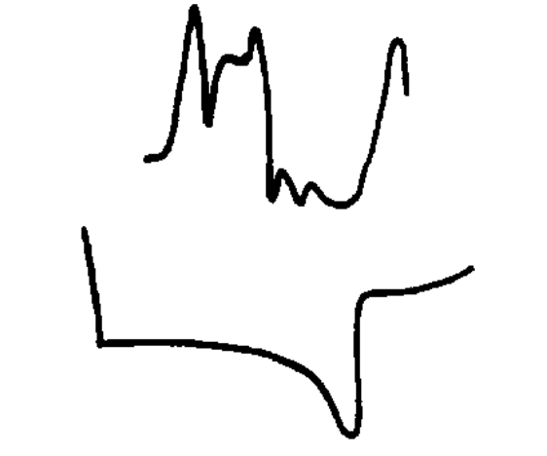
Motivation:
:
:
Most research effort in this area is devoted to obtaining good feature representation for signatures, means designing good feature extractors.Recent offline signature verification systems are based on texture features, global features, etc. Example:
Fig: Envelope for sign Fig: grid overlaid Fig: Feature vector for upper envelope

Slide 9
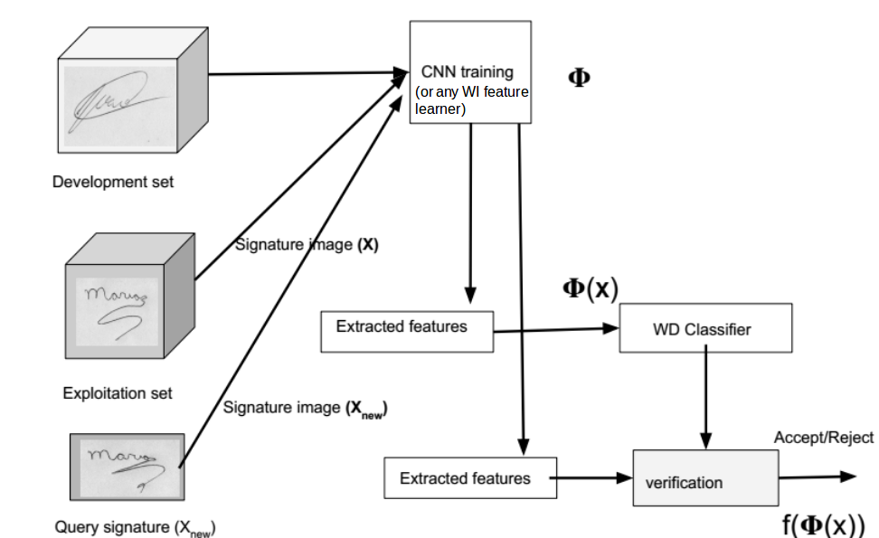
Current approach

Slide 10
Datasets:
GPDS960 signature database: Contains samples from 881 users, 24 genuine and 30 skilled forgeries per user.
GPDSsyntheticOnLineOffLineSignature database: It contains data from 1000 synthetic individuals: 24 genuine signatures for each individual, plus 30 forgeries per user.

Slide 11
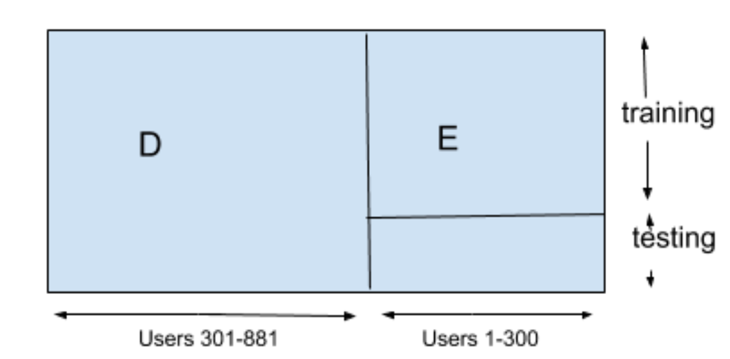
Dataset split:
Users 301-1000
Users 1-300
Fig: Separation of GPDS960 & GPDSSynthetcSignature dataset into development set D and exploitation set E

Slide 12
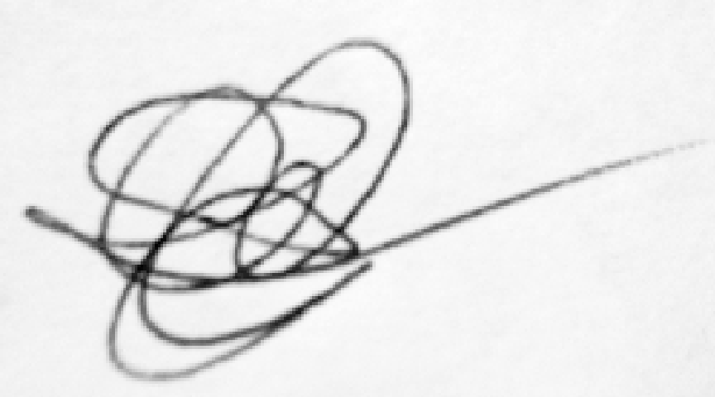

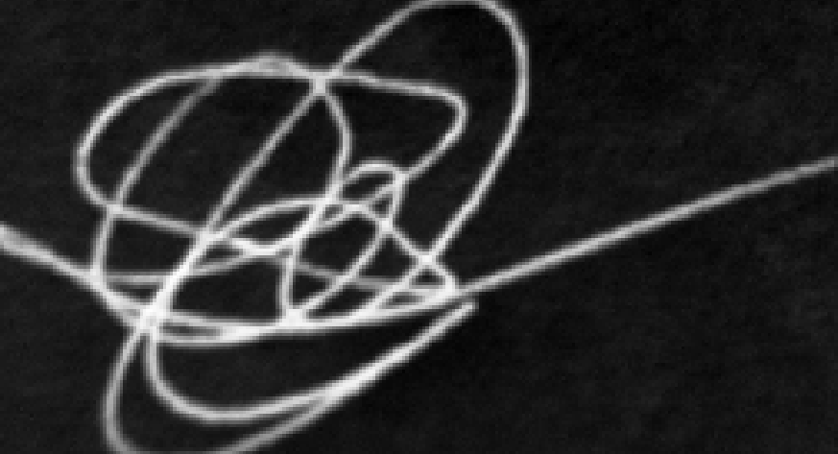
Preprocessing
Put image on canvas of size 840X1360.
Remove background using OTSU’s algorithm. (set background pixels to intensity 255)
Invert the image I(x,y)=255-I(x,y)
Resize and crop the image to final size of 150X220

Slide 13
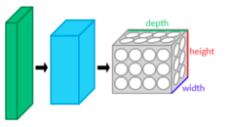
Convolutional Neural Networks
Three types of layers:
1. Convolutional layer
2. Pooling layer
3..Fully connected layer

Slide 14
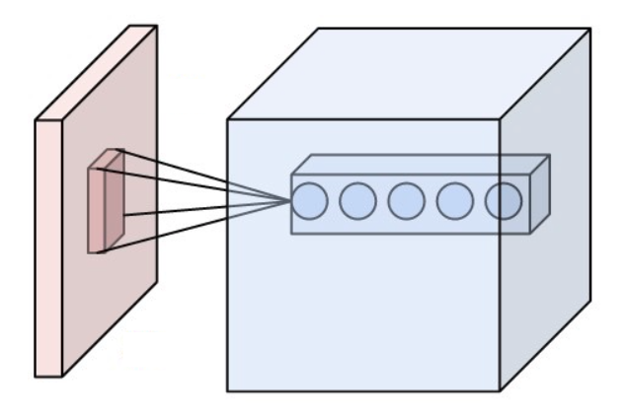
1. Convolutional layer
Core building block of a CNN. The layer's parameters consist of a set of learnable filters (or kernels), which have a small receptive field, but extend through the full depth of the input volume.
Fig: Neurons in convolutional layers are connected to the receptive field
Notes:
During the forward pass, each filter is convolved across the width and height of the input volume, computing the dot product between the entries of the filter and the input and producing a 2-dimensional activation map of that filter. As a result, the network learns filters that activate when it detects some specific type of feature at some spatial position in the input.

Slide 15

2. Pooling layer
Down sampling in non linear form. In max pooling partition image into non overlapping rectangles and for each region output the maximum.
3. Fully connected layer
Neurons in a fully connected layer have connections to all activations in the previous layer, as seen in regular neural networks.
Notes:
The intuition is that the exact location of a feature is less important than its rough location relative to other features. Pooling layers help in reducing parameters and computations and so controlling the overfitting

Slide 16
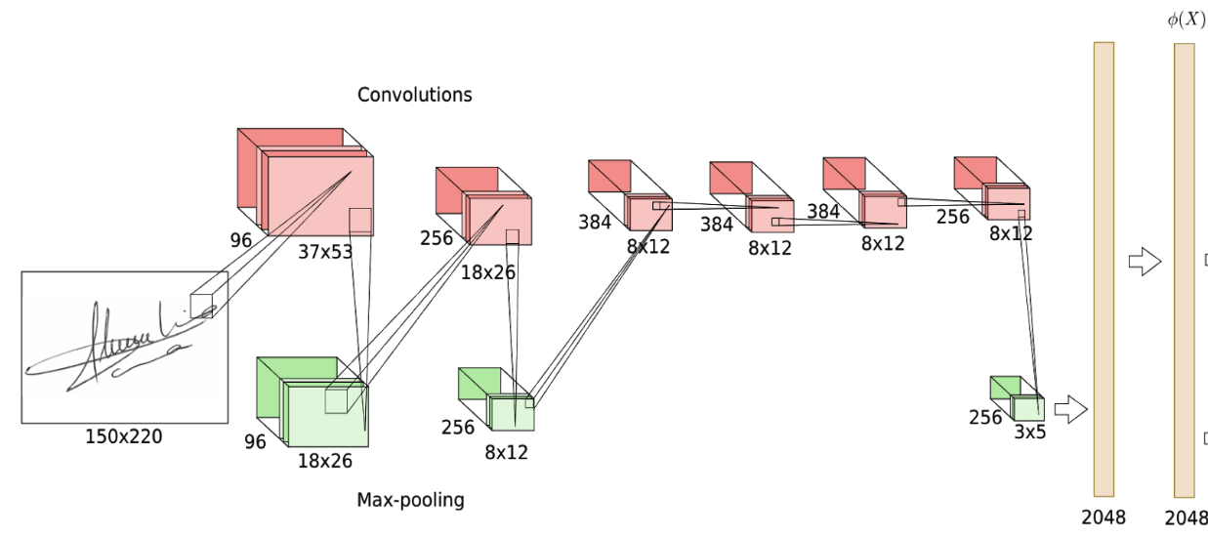
CNN for WI Feature learning
Fig: CNN architecture
Notes:
Each user in D considered as a different class,

Slide 17
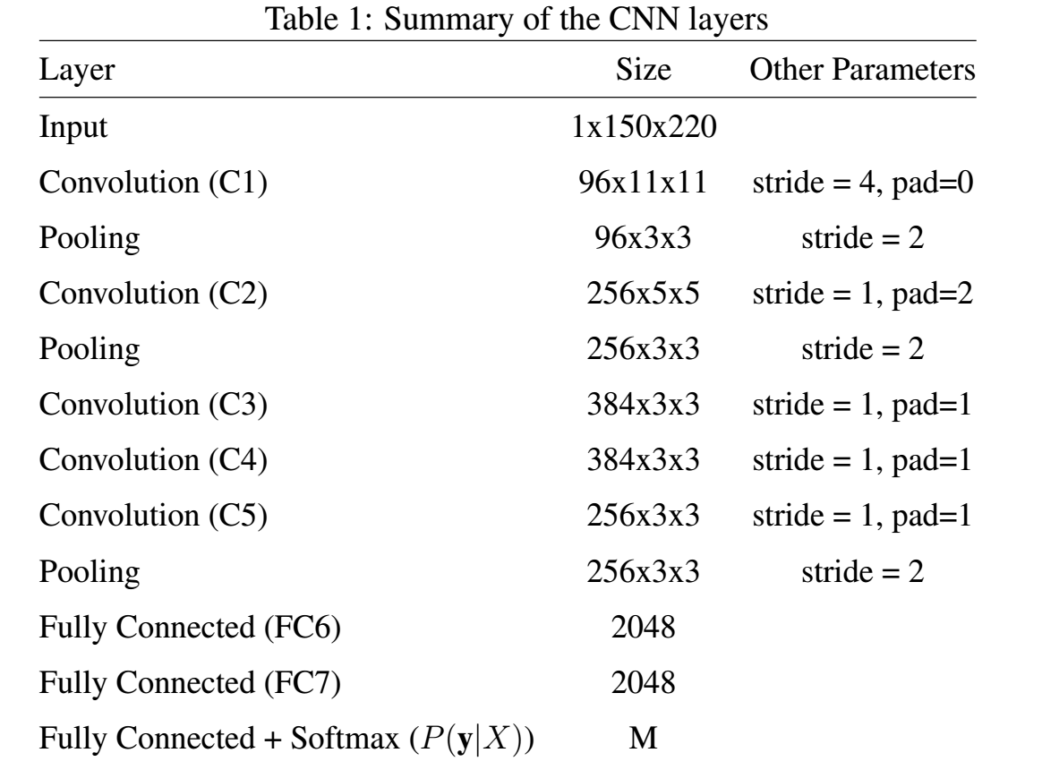
Notes:
Each user in D considered as a different class,
-Objective fn is to minimize cross entropy loss
-model is similar to one defined by”Alex Krizhevsky” “ImageNet Classification with Deep Convolutional
Neural Networks”
-

Slide 18
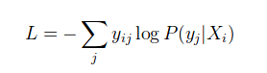
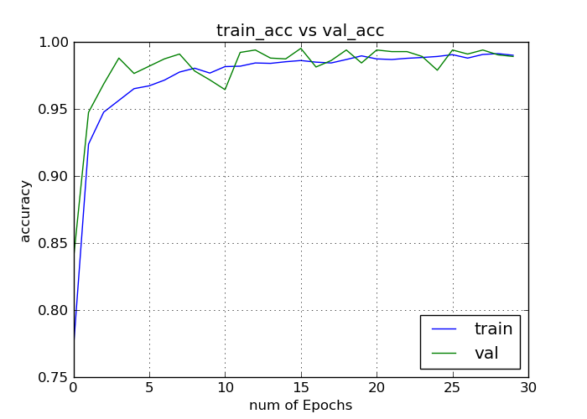
Loss function:
Where y_{ij} is the true target for example i
P(y_{j} |X_{i}) is the probability assigned to class j for the input X_{i}
Optimizer: rmsprop
Fig: CNN training curve

Slide 19
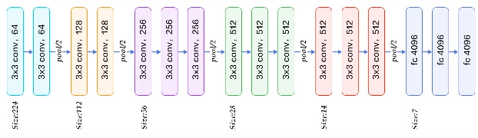
Pretrained models as feature learners
1. Vgg16: Uses 3x3 convolution and 2x2 pooling are used throughout the whole network, also shows that the depth of the network plays an important role. Deeper networks give better results.
Fig: Vgg16 model layers

Slide 20
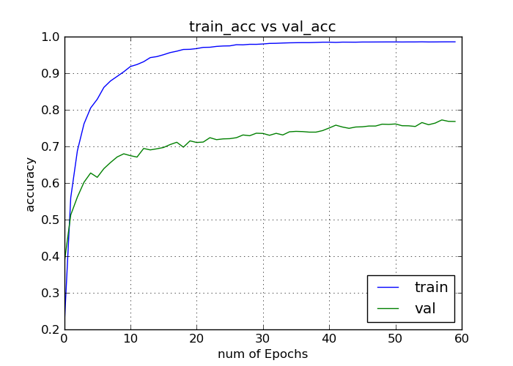
Layer (type) Output Shape Param #
_________________________________________________________
input_1 (InputLayer) (None, 224, 224, 3) 0
block1_conv1 (Conv2D) (None, 224, 224, 64) 1792
block1_conv2 (Conv2D) (None, 224, 224, 64) 36928
block1_pool (MaxPooling2D) (None, 112, 112, 64) 0
block2_conv1 (Conv2D) (None, 112, 112, 128) 73856
block2_conv2 (Conv2D) (None, 112, 112, 128) 147584
block2_pool (MaxPooling2D) (None, 56, 56, 128) 0
block3_conv1 (Conv2D) (None, 56, 56, 256) 295168
block3_conv2 (Conv2D) (None, 56, 56, 256) 590080
block3_conv3 (Conv2D) (None, 56, 56, 256) 590080
block3_pool (MaxPooling2D) (None, 28, 28, 256) 0
block4_conv1 (Conv2D) (None, 28, 28, 512) 1180160
block4_conv2 (Conv2D) (None, 28, 28, 512) 2359808
block4_conv3 (Conv2D) (None, 28, 28, 512) 2359808
block4_pool (MaxPooling2D) (None, 14, 14, 512) 0
block5_conv1 (Conv2D) (None, 14, 14, 512) 2359808
block5_conv2 (Conv2D) (None, 14, 14, 512) 2359808
block5_conv3 (Conv2D) (None, 14, 14, 512) 2359808
block5_pool (MaxPooling2D) (None, 7, 7, 512) 0
flatten (Flatten) (None, 25088) 0
fc1 (Dense) (None, 256) 6422784
fc2 (Dense) (None, 256) 65792
output (Dense) (None, 700) 179900
=================================================================
Total params: 21,383,164
Trainable params: 21,383,164
Non-trainable params: 0
_________________________________________________________________

Slide 21
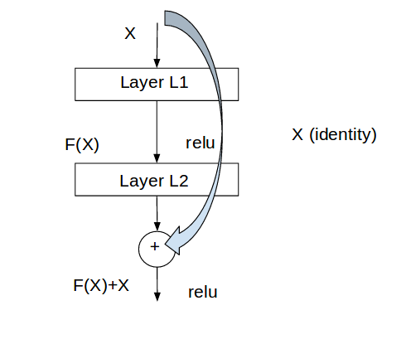
2.ResNet50: It contains skipped connections, which solves the problem of training deep networks and vanishing gradients.
Fig: Residual learning- building block

Slide 22
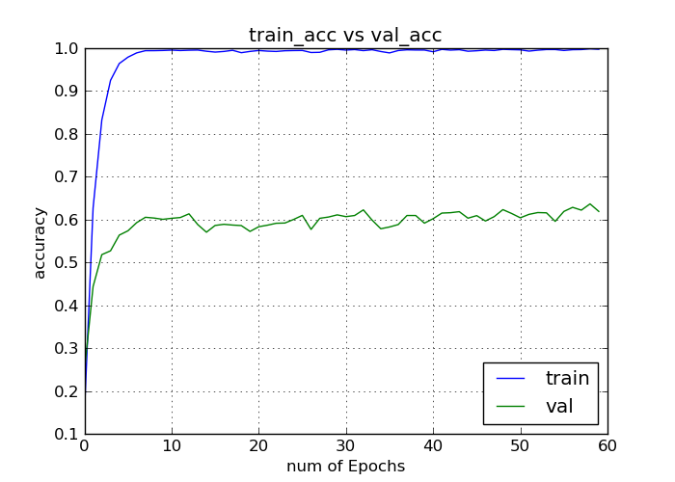
__________________________________________________________________________________________________________________________________________
Layer (type) Output Shape Param # Connected to
=============================================================================================
input_2 (InputLayer) (None, None, None, 3 0
conv1_pad (ZeroPadding2D) (None, None, None, 3 0 input_2[0][0]
.
.
.
.
.
activation_49 (Activation) (None, None, None, 2 0 add_16[0][0]
avg_pool (AveragePooling2D) (None, None, None, 2 0 activation_49[0][0]
global_average_pooling2d_1 (Glo (None, 2048) 0 avg_pool[0][0]
fc-1 (Dense) (None, 512) 1049088 global_average_pooling2d_1[0][0]
dropout_1 (Dropout) (None, 512) 0 fc-1[0][0]
fc-2 (Dense) (None, 256) 131328 dropout_1[0][0]
dropout_2 (Dropout) (None, 256) 0 fc-2[0][0]
output_layer (Dense) (None, 700) 179900 dropout_2[0][0]
==================================================================================================
Total params: 24,948,028
Trainable params: 24,894,908
Non-trainable params: 53,120
__________________________________________________________________________________________________

Slide 23
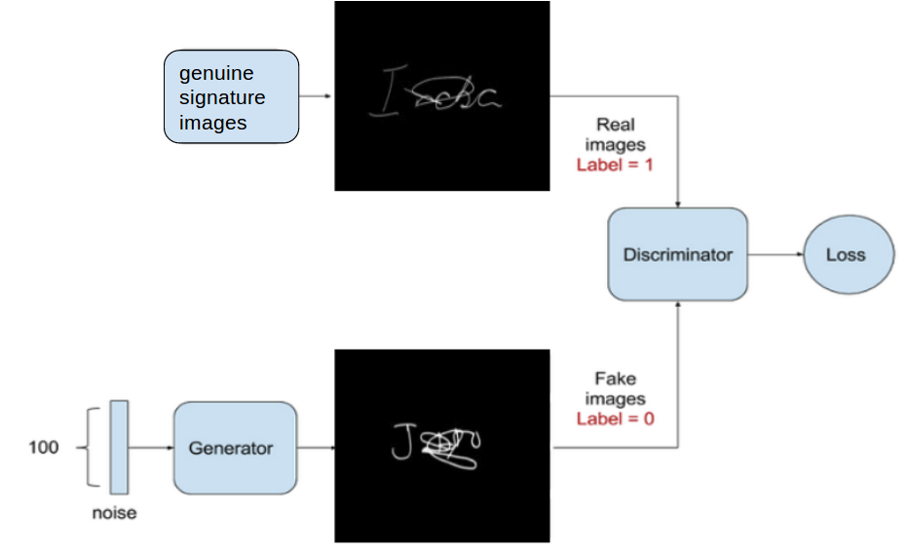
DCGAN as feature learners
Discriminator model
optimizer = RMSprop(lr=0.0008, clipvalue=1.0,decay=6e-8)
self.DM = Sequential()
self.DM.add(self.discriminator())
self.DM.compile(loss='binary_crossentropy',optimizer=optimizer,metrics=['accuracy'])
Fig: Discriminator model training

Slide 24
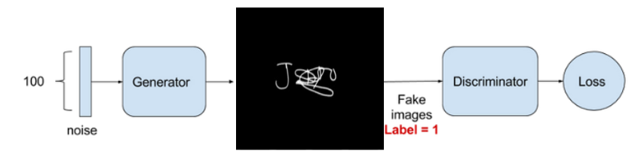
Adversarial Model
optimizer = RMSprop(lr=0.0004, clipvalue=1.0, decay=3e-8)
self.AM = Sequential()
self.AM.add(self.generator())
self.AM.add(self.discriminator())
self.AM.compile(loss='binary_crossentropy', optimizer=optimizer,metrics=['accuracy'])
Fig: Adversarial model training

Slide 25
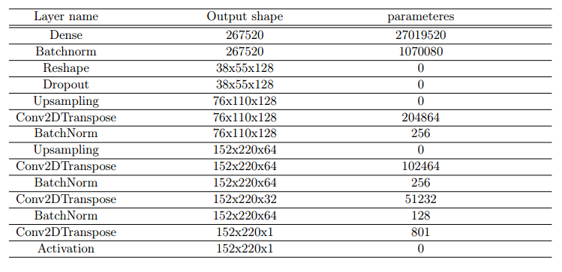
DCGAN generator model:

Slide 26
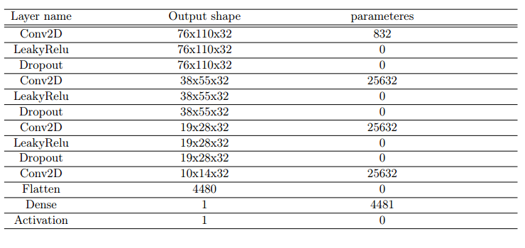
DCGAN discriminator model:

Slide 27
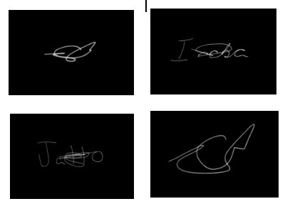
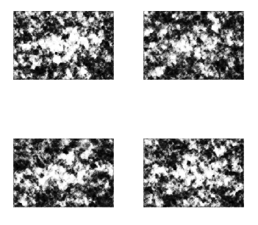
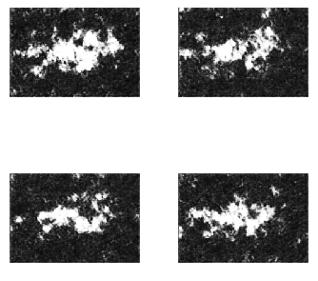
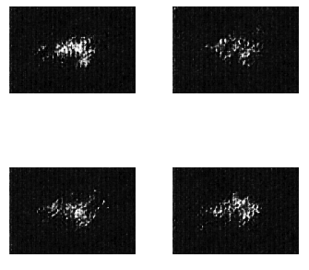
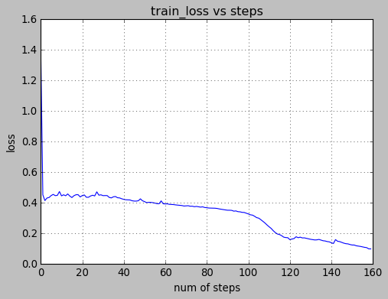
Original images
After 40 steps
After 120 steps
After 160 steps
Fig: discriminator loss

Slide 28
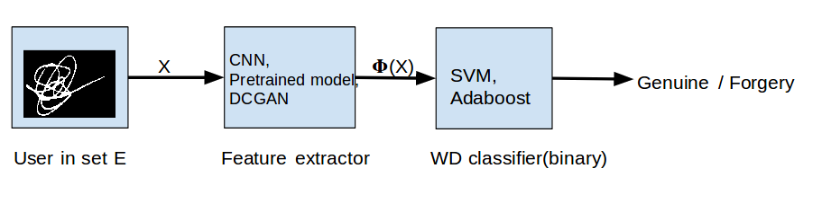
Writer dependent classification

Slide 29
C.Writer dependent classification
Feature extractor function φ(.) is representation of network at last layer before softmax. (φ(X) E R²⁰⁴⁸)
14
24 30
24 30
class:1
real
forg
real
forg
class:0
14x531
E
D
Training set
10
class:1
X:0
FRR=X/10
531
300
30
class:0
Y:1
FAR=Y/30
Testing set
Notes:
Idea: features learned for set D during CNN training will be relevant for other users ( in exploitation set)

Slide 30
Results
1. GPDS960 Dataset
Dataset | Features | WD Classifier | FRR | FAR
GPD960 | CNN | SVM (linear) | 2.52 | 15.18
GPD960 | CNN | SVM (rbf) | 2.26 | 14.06
GPDS960 | CNN | SVM(Adaboost) | 3.85 | 11.28

Slide 31
2. GDPSSyntheticSignature Dataset
Dataset | Features | WD Classifier | FRR | FAR
GPDSSyntheticSignature | CNN_GPDS | SVM (linear) | 3.01 | 15.98
GPDSSyntheticSignature | CNN_GPDS | SVM (rbf) | 6.83 | 16.87
GPDSSyntheticSignature | Vgg16 | SVM (linear) | 33.01 | 9.66
GPDSSyntheticSignature | Vgg16 | SVM (rbf) | 26.84 | 11.33
GPDSSyntheticSignature | ResNet50 | SVM (rbf) | 61.32 | 7.33
GPDSSyntheticSignature | DCGAN | SVM(linear) | 31.78 | 27.98

Slide 32
Comparison with state of the art on GPDS960
Type | Features, Algorithm | #Reference | FRR | FAR
WD[6] | Wavelet(SVM) | 5 | 24.77 | 5.87
WD[7] | LPB, HOG (SVM) | 10 | 9.66 | 8.64
WD[8] | Feature learning (SVM) | 12 | 3.94 | 3.53
WD[9] | DCGAN+Adaboost | 14 | 18.74~26.13 | 17.35~26.74
WD | Featurelearning (Adaboost) | 14 | 3.95 | 11.34

Slide 33
Conclusion and Future scope
-Combine results of both WI and WD classifier to verify a signature.
-Generalization of representation learning on some other available datasets (MYCT, ICDAR).
-Explore unsupervised learning methods for representation learning (DCGAN’s)
-Improve performance of WD systems when very less number of samples are available per users.

Slide 34
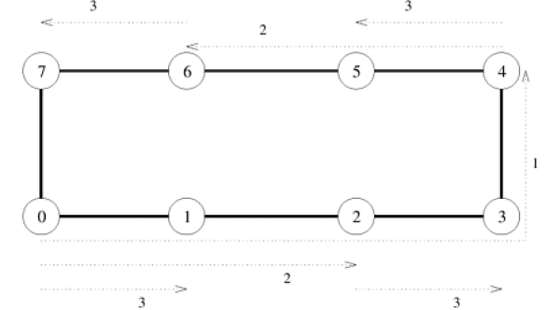
Computer Architecture projects
Simulation of “Merge Sort” using Parallel Processor Architecture :
Fig:One -to- all broadcast on eight node ring. Node 0 is source of broadcast

Slide 35
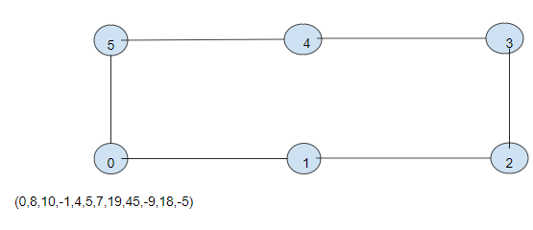
Data distribution
Fig: Initially one processor has the list of numbers

Slide 36
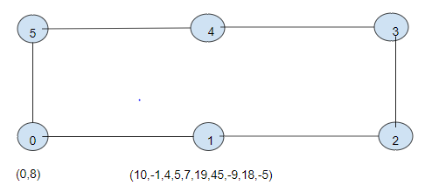
Fig: After one time stamp

Slide 37
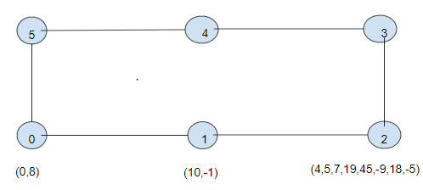
Fig: After two time stamps

Slide 38
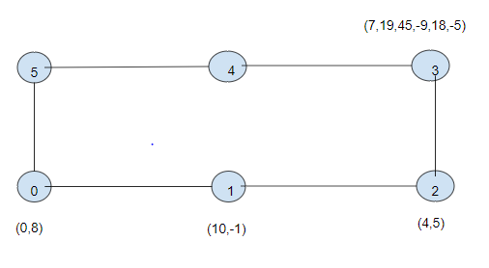

Slide 39
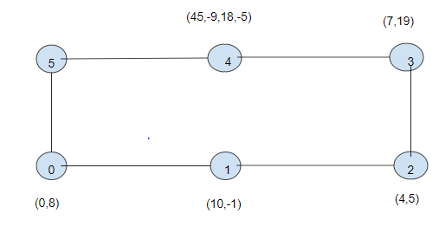

Slide 40
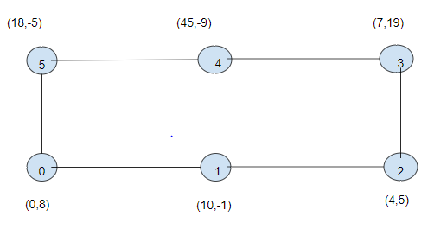
Fig: Finally each processor contains two numbers

Slide 41
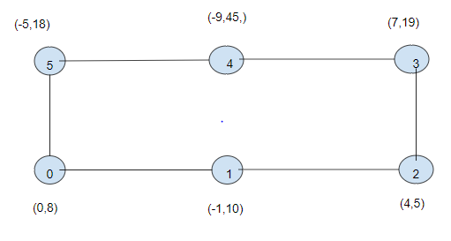
Sorting at each node
Fig: Numbers are sorted at each of the processor

Slide 42
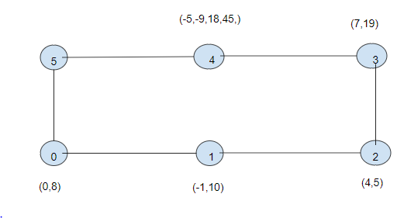
Now Merging

Slide 43
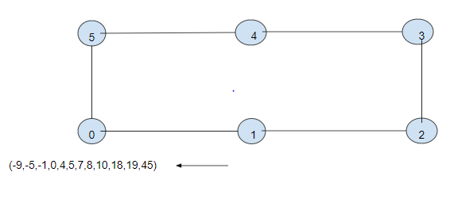
Fig: Finally node 0 contains sorted list of numbers

Slide 44
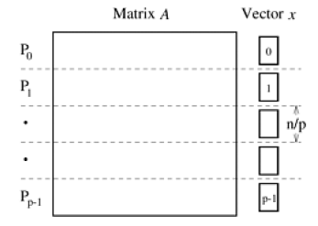
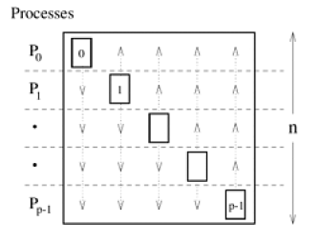
2. Matrix multiplication using parallel processor architecture
(a) Initial partitioning of the matrix and the starting vector x
(b) Distribution of the full vector among the processes by all to all broadcast

Slide 45
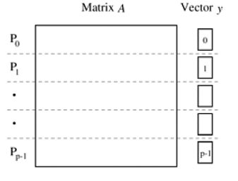
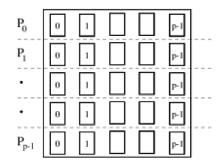
(c) Entire vector distributed to each process after broadcast
(d) Final distribution the matrix and the result vector y

Slide 46
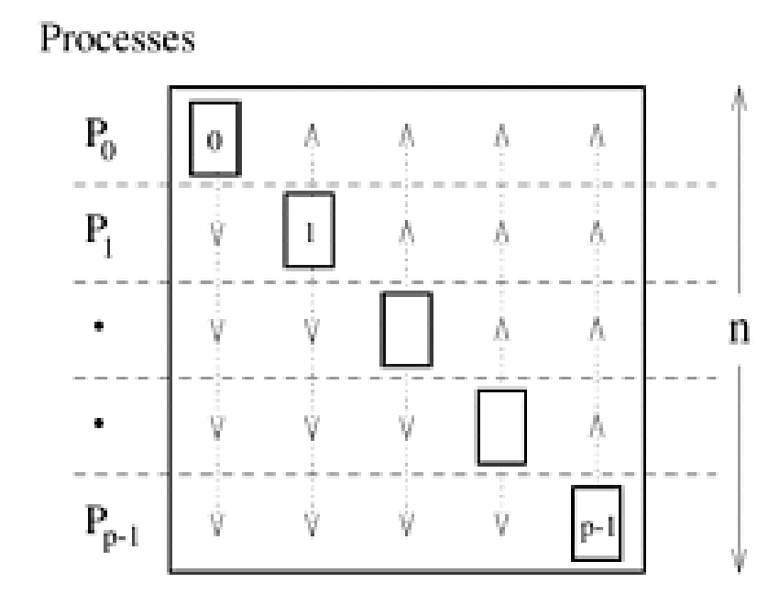
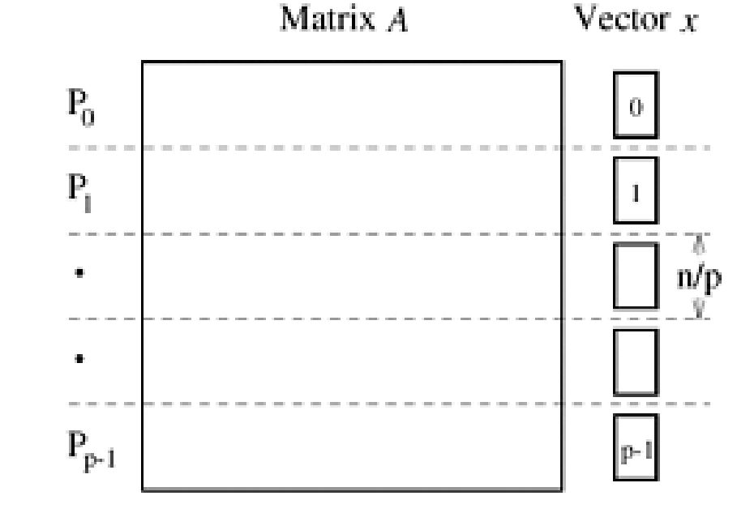
2. Matrix multiplication using wraparound mesh:
(a) Initial partitioning of matrix and intitial vector x
(b) Distribution of the full vector among all processes by all to all broadcast

Slide 47
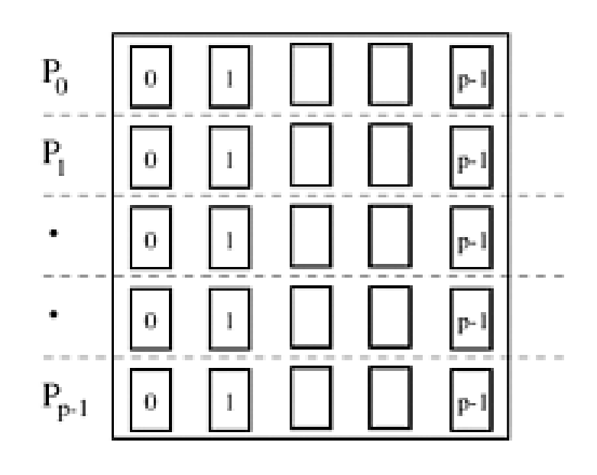
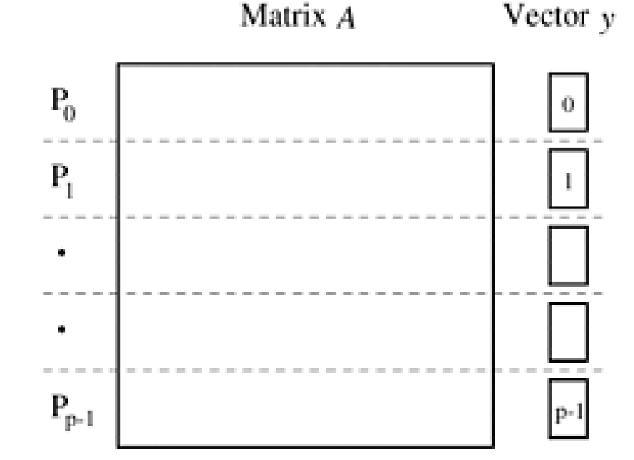
(c) Entire vector distributed to each process after broadcast
(d) Final distribution of matrix and result vector y

Slide 48

Operating Systems projects
1. Design of FTP Application (interprocess communication)
Implemented communication between server and multiple clients for both TCP and UDP connections using socket programming with client able to run ls, cd ,chmod ,lls, lcd, lchmod, put, get (file transfer) close, etc.
Image source: wikipedia
Notes:
Sockets are perhaps the best-known and most flexible mechanism for inter-process communication. The assignment aims to make one comfortable with TCP/IP sockets across different computers. ftp is a complex protocol to transfer files across a network. The assignment seeks to get a bare-bones implementation of the main part of the file transfer, without bothering about connections, authentication, encryption and access issues.

Slide 49
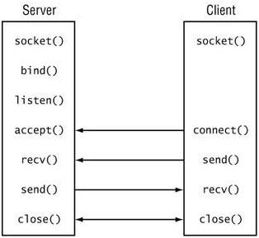
Fig: Steps involved in client server communication

Slide 50
Program outline
At server side:
1. Creating end point point for communication (socket - Linux socket interface)
int socket(int domain, int type, int protocol);
The domain argument specifies a communication domain, this selects the protocol family.
AF_INET : IPv4 Internet protocols
AF_INET6 : IPv6 Internet protocols

Slide 51
The socket has the indicated type, which specifies the communication semantics. Currently defined types are:
SOCK_STREAM :Provides sequenced, reliable, two-way, connection-based byte streams. An out-of-band data transmission mechanism may be supported.
SOCK_DGRAM :Supports datagrams (connectionless, unreliable messages of a fixed maximum length).
The protocol specifies a particular protocol to be used with the socket
2. Assigning an address to the socket
int bind(int sockfd, const struct sockaddr *addr, socklen_t addrlen);
On success, zero is returned. On error, -1 is returned, and errno is set appropriately.

Slide 52
3. listen for connections on a socket
int listen(int sockfd, int backlog);
listen( ) marks the socket referred to by sockfd as a passive socket, that is, as a socket that will be used to accept incoming connection requests using accept(2).
The backlog argument defines the maximum length to which the queue of pending connections for sockfd may grow.

Slide 53
4. Accept a connection on a socket
int accept(int sockfd, struct sockaddr *addr, socklen_t *addrlen)
5. Read from a file descriptor/ Write to a file descriptor
ssize_t read(int fd, void *buf, size_t count);
ssize_t write(int fd, const void *buf, size_t count);
read() attempts to read up to count bytes from file descriptor fd into the buffer starting at buf.
write() writes up to count bytes from the buffer pointed buf to the file referred to by the file descriptor fd.
Notes:
The argument addr is a pointer to a sockaddr structure. This structure is filled in with the address of the peer socket, as known to the communications layer. The exact format of the address returned addr is determined by the socket's address family (see socket(2) and the respective protocol man pages). When addr is NULL, nothing is filled in; in this case, addrlenis not used, and should also be NULL.
The addrlen argument is a value-result argument: the caller must initialize it to contain the size (in bytes) of the structure pointed to by addr; on return it will contain the actual size of the peer address.

Slide 54
At client side:
1. Creating end point point for communication (socket - Linux socket interface)
int socket(int domain, int type, int protocol);
2. Connect - initiate a connection on a socket
int connect(int sockfd, const struct sockaddr *addr, socklen_t addrlen);
The connect() system call connects the socket referred to by the file descriptor sockfd to the address specified by addr.
If the connection or binding succeeds, zero is returned. On error, -1 is returned, and errno is set appropriately.

Slide 55
3. Read from a file descriptor/ Write to a file descriptor
ssize_t read(int fd, void *buf, size_t count);
ssize_t write(int fd, const void *buf, size_t count);
read() attempts to read up to count bytes from file descriptor fd into the buffer starting at buf.
write() writes up to count bytes from the buffer pointed buf to the file referred to by the file descriptor fd.

Slide 56
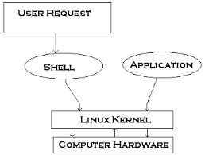
Implementation of a shell
Shell utility to transfer files.
Write a shell in C/C++ which parse user inputs, and if required, spawn other processes (which necessitates the use of the fork and exec family of instructions
Notes:
A shell or a command interpreter, is one of the most important parts of an Operating System. It is the job of the shell to parse user inputs, and if required, spawn other processes (which necessitates the use of the fork and exec family of instructions, for any Operating System. UNIX has a large number of shells, the Bourne Shell sh, the Bourne-Again Shell bash, the C Shell csh, tcsh, ash, the Korn Shell ksh, zsh, and others. For Windows, it is the command interpreter cmd. The login shell is listed in the login record, so that /bin/login (the program that prompts for the password), knows what shell to start in, when a login happens. This assignment considers the design of a simple shell, from scratch.

Slide 57
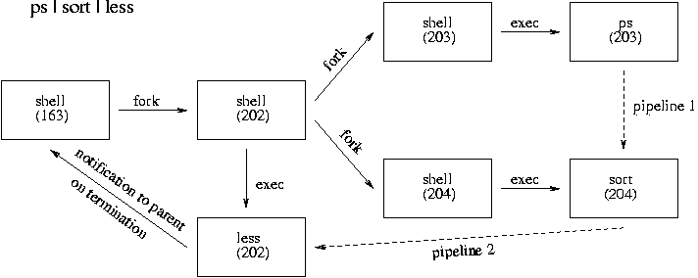
Fig: Forking in shell implementation

Slide 58
The path variable holds a list of possible paths in which to search for executables The list of paths is empty by default, but may grow to any arbitrary size. You should implement a built-in command to control this variable: path [+|- /some/dir]
path (without arguments) displays all entries in the list separated by colons e.g., /bin:/usr/bin.
path + /some/dir appends the given pathname to the path list.
path - /some/dir removes the given pathname from the path list.

Slide 59
Data Structure projects
1. Prims algorithm on undirected weighted graphs for minimum spanning tree
Similar to Dijkstra’s Algorithm except that dv records edge weights, not path lengths.
Time complexity: O(n^2)

Slide 60


Slide 61


Slide 62


Slide 63


Slide 64


Slide 65


Slide 66


Slide 67


Slide 68


Slide 69


Slide 70


Slide 71


Slide 72


Slide 73


Slide 74


Slide 75


Slide 76


Slide 77
Sketch of Prim's algorithm
procedure Prim ( G: graph; var T: set of edges );
{ Prim constructs a minimum-cost spanning tree T for G }
var
U: set of vertices;
u, v: vertex;
begin
T:= Ø;
U := {1};
while U ≠ V do begin
let (u, v) be a lowest cost edge such that
u is in U and v is in V-U;
T := T ∪ {(u, v)};
U := U ∪ {v}
end
end; { Prim }

Slide 78
2. Kruskal’s algorithm on undirected weighted graphs
Work with edges, rather than nodes
Two steps:
Sort edges by increasing edge weight
Select the first |V| – 1 edges that do not generate a cycle

Slide 79


Slide 80


Slide 81


Slide 82


Slide 83


Slide 84


Slide 85


Slide 86


Slide 87


Slide 88


Slide 89


Slide 90


Slide 91


Slide 92


Slide 93
procedure Kruskal ( V: SET of vertex;
E: SET of edges;
var T: SET of edges );
Var
ncomp: integer; { current number of components }
edges: PRIORITYQUEUE; { the set of edges }
components: MFSET; { the set V grouped into a MERGE-FIND set of components }

Slide 94
u, v: vertex;
e: edge;
nextcomp: integer; { name for new component }
ucomp, vcomp: integer; { component names }
begin
MAKENULL(T);
MAKENULL(edges);
nextcomp := 0;
ncomp := number of members of V;
for v in V do begin { initialize a
component to contain one vertex of V }
nextcomp := nextcomp + 1;
INITIAL( nextcomp, v, components)
end;

Slide 95
for e in E do { initialize priority queue of edges }
INSERT(e, edges);
while ncomp > 1 do begin { consider next edge }
e := DELETEMIN(edges);
let e = (u, v);
ucomp := FIND(u, components);
vcomp := FIND(v, components);
if ucomp <> vcomp then begin
{ e connects two different components }
MERGE (ucomp, vcomp, components);
ncomp := ncomp - 1;
INSERT(e, T)
end
end
end; { Kruskal }

Slide 96
Deep Learning projects
1. Frame-wise identification of the dominant speaker in videos
Introduction ​: In this assignment we need to identify the dominant speaker in youtube videos, where:
We have six speakers, 7-classes (class-7 for none).
Sandeep Maheshwari
Raman Flute
Sadhguru
Saurabh Pant
Atul Khatri
Shailendra Kumar

Slide 97
We used object detection methods like: CascadeClassifier in ​opencv ​, ​yolo object detection algorithm to detect person in video frames.
We are training some CNN architectures like: VGG16 ​, ​ResNet50 ​, ​InceptionNetv3 ​, etc with various settings on extracted frames and also on detected faces from frames.

Slide 98

Fig: This frame needs to be discarded (too many persons !!!!!)

Slide 99
Dataset preparation:
● Downloaded 20-25 videos (720p) of each speaker from youtube.
● We used different videos for frame extraction rather than extracting more frames from same video.
● Used VideoCapture() and read() opencv functions to extract frames from videos with desired rate.
● We First tried Haar CascadeClassifier in opencv for face detection from frames:
​Advantages ​: Speed, good performance.
Limitation ​: Sadhguru’s face not detected.

Slide 100

Fig: Sadhguru (problem in face detection due to beard)

Slide 101
So we moved to ​Yolo ​ algorithm
Split frames into 2 categories using yolo:
1.Frames without person object.
2.Frames with person object.
After that Frames with person again split into two categories:
1. Frames with one person.
2. Frames with multiple persons.

Slide 102
For frames with multiple persons we cropped the
person with highest probability of person (more than 98%) given by yolo.
Now frames with one person Further split into:
1.Required speaker
2. Other person

Slide 103
3. Training and testing:
3.1 VGG16 with only classifier trained
● Using video frames as it is (face detection not applied): Here we freezed all the layers and training only classifier (softmax) having 7 classes with our data.
No. of examples | No. of epochs | Validation acc. | Test acc.
8297 | 30 | 99.54% | 62.05%
3142 | 30 | 98.73% | 59.08%

Slide 104


Slide 105
3.3 Resnet50 with only classifier trained
Training with detected faces
No. of examples | No. of epochs | Validation acc. | Test acc.
7623 | 30 | 99.74% | 75.16%
8297 | 30 | 99.80% | 71.54%

Slide 106


Slide 107

Healthcare project
Detecting Diabetic Retinopathy Detection With Deep Learning

Slide 108
What is DR ?
When high blood sugar levels cause damage to blood vessels in the retina. These blood vessels can swell and leak. Or they can close, stopping blood from passing through. Sometimes abnormal new blood vessels grow on the retina. All of these changes can steal your vision.
Affects up to 80 % of people who have diabetes for 20 years or more
90% of new cases are reducible

Slide 109
DATA
The data originates from a 2015 Kaggle competition.
All images are taken of different people, using different cameras, and of different sizes. Pertaining to the preprocessing section, this data is extremely noisy, and requires multiple preprocessing steps to get all images to a useable format for training a model.
The training data is comprised of 35,126 images, which are augmented during preprocessing.

Slide 110
A left and right field is provided for every subject. Images are labeled with a subject id as well as either left or right (e.g. 1_left.jpeg is the left eye of patient id 1).
A clinician has rated the presence of diabetic retinopathy in each image on a scale of 0 to 4, according to the following scale:
0 - No DR
1 - Mild
2 - Moderate
3 - Severe
4 - Proliferative DR

Slide 111


Slide 112


class 0 (no retinopathy)
class 4 (proliferative retinopathy)

Slide 113
Preprocessing
The preprocessing pipeline is the following:
Crop & resize all images using the resizing script and the preprocessing script.
Rotate & mirror all images using the rotation script.
Convert all images to array of NumPy arrays, using the conversion script.

Slide 114



Slide 115





CONVOLUTIONAL NEURAL NETWORK
Learning an image
Some patterns are much smaller than the whole image
Can represent a small region with fewer parameters
source:https://cs.uwaterloo.ca/~mli/Deep-Learning-2017-Lecture5CNN.ppt

Slide 116


Same pattern appears in different places:They can be compressed!
What about training a lot of such “small” detectors and each detector must “move around”.
They can be compressed
to the same parameters.
source:https://cs.uwaterloo.ca/~mli/Deep-Learning-2017-Lecture5CNN.ppt

Slide 117

A convolutional layer
A CNN is a neural network with some convolutional layers (and some other layers). A convolutional layer has a number of filters that does convolutional operation.
Beak detector
source:https://cs.uwaterloo.ca/~mli/Deep-Learning-2017-Lecture5CNN.ppt

Slide 118

source:https://cs.uwaterloo.ca/~mli/Deep-Learning-2017-Lecture5CNN.ppt

Slide 119

Model : Resnet (By Microsoft)
Fig: Residual block

Slide 120

Transfer learning with resnet50

Slide 121
Results
S. No. | Model | #samples | #epochs | Val. accuracy | Test accuracy
1 | resnet50 (only classifier trained) | 8006 | 20 | 71.64% | 69.154%
2 | resnet50 (fc layer trained) | 8006 | 16 | 73.58% | 69.075%

Slide 122


